Slide 1
MAXIMIZING YOUR HOME INVESTMENT:
A MACHINE LEARNING EXERCISE ON HOUSING
Fuentes, Pecundo, Villegas

Slide 2
INTRODUCTION

Slide 3
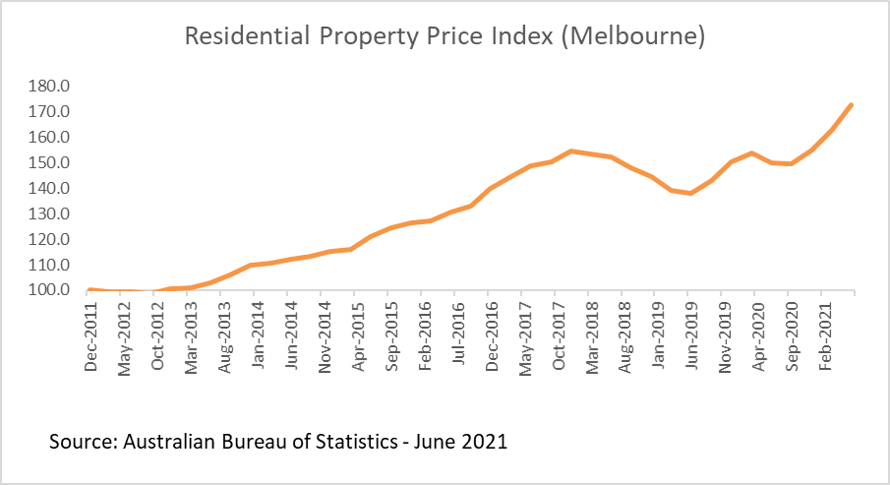
BACKGROUND
Australians traditionally place a high degree of importance on homeownership, making houses in demand (Eslake, 2017).
There has been a problem with housing in Australia though
Over time, rates of houses are rapidly increasing, especially in Melbourne compared to suburban areas
The cause?
Low tax rates
Increasing demand but low supply
Notes:
https://www.abs.gov.au/statistics/economy/price-indexes-and-inflation/residential-property-price-indexes-eight-capital-cities/jun-2021

Slide 4
BACKGROUND
The COVID-19 pandemic has worsened affordability
Real estate agents have resumed operations post-lockdown while buyers have not fully recovered yet from financial losses
Notes:
https://www.abs.gov.au/statistics/economy/price-indexes-and-inflation/residential-property-price-indexes-eight-capital-cities/jun-2021

Slide 5
AUDIENCE
First-time house buyers
Families
Professionals who Buy-and-rent (e.g. AirBnB)
Notes:
https://www.abs.gov.au/statistics/economy/price-indexes-and-inflation/residential-property-price-indexes-eight-capital-cities/jun-2021

Slide 6
SIGNIFICANCE OF THE STUDY
Value is what buyers are looking for
Value is dependent on
Lifestyle
Affordability in the context of Budget
The study can help buyers regulate their expected expenses based on the predicted price of their preferred house characteristics
Choose the house that gives them the most bang for their buck through data-driven decisions
Careful decision making is required to be able to maximize the value

Slide 7
OBJECTIVES
Can we predict the price of a house by knowing the house’s other characteristics?
What properties of a house contribute the most to its value?

Slide 8

MELBOURNE HOUSING DATA (DOMAIN.AU)
Publicly available on Kaggle
Data scraped from Domain.au; an Australian real estate market website
Around 34,000+ houses listed in the dataset

Slide 9
FEATURES
Location
Address, Region, Council, Longitude, Latitude
House Features
Rooms, Bathroom, Car Parking Size, Building Size
Setting
Land size, Property Count in the Area, Distance from the Central Business District

Slide 10
METHODOLOGY: PRE-PROCESSING

Slide 11
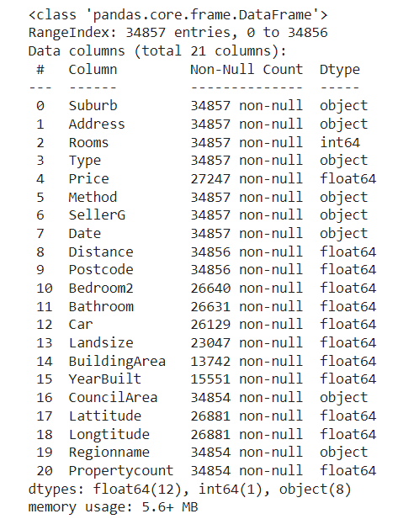
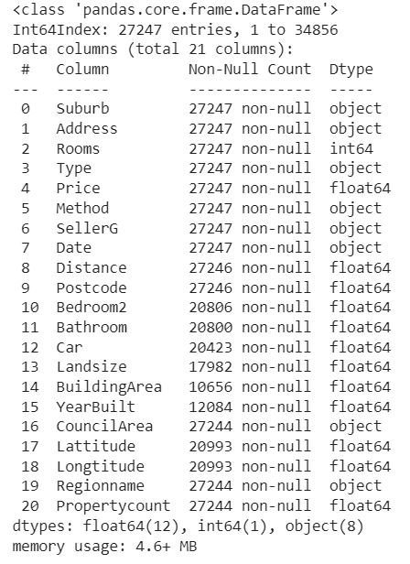
OBSERVATIONS WITH MISSING “PRICE” WERE REMOVED
Observations with missing “Price” were removed
After cleaning

Slide 12
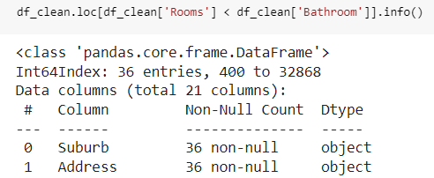
CAR, BATHROOM, AND LANDSIZE FEATURES WERE CLEANED
Removed cases where “Bathroom” had larger number than “Room”
Observations with missing “Car”, “Bathroom”, and “Landsize” were imputed using KNN Imputer
Following features were considered in KNN Imputer: Rooms, Type, Car, Bathroom, Land size
Imputation was done separately for training and test set

Slide 13
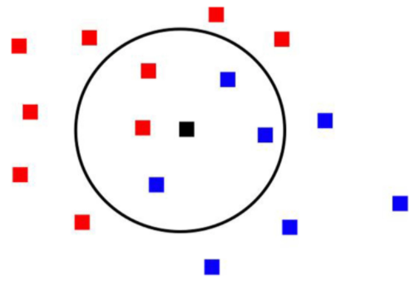
K-NEAREST NEIGHBORS IMPUTATION
Maps observations as points on a space, based on the features selected, and locates the nearest neighbors based on common features
Missing data is predicted based on average value of nearest neighbors; count of neighbors chosen is decided by a parameter k, selected for the model
Notes:
Image taken from: https://www.researchgate.net/figure/In-this-k-Nearest-Neighbor-illustration-with-k-5-the-central-black-square-more_fig1_281289672

Slide 14
REMAINING MISSING AND ATYPICAL FEATURES WERE REMOVED
Observations with missing “Distance” were removed
This was done both for training and test dataset
1 observation was removed (1 from training dataset)
Observations with missing “Propertycount” were removed
This was done both for training and test dataset
3 observations were removed (2 from training dataset and 1 from test dataset)
Total observations were reduced from 34,857 to 27,208 (28% reduction)
Most reductions were from missing “Price”

Slide 15
FINAL FEATURES WERE SELECTED
Input Features:
Number of rooms
Type of house (dummy encoded)
Distance from city center
Property count within area
Region (dummy encoded)
Number of bathrooms
Number of car parking spaces
Land size
Target Feature:
Price

Slide 16
METHODOLOGY: MODEL BUILDING

Slide 17
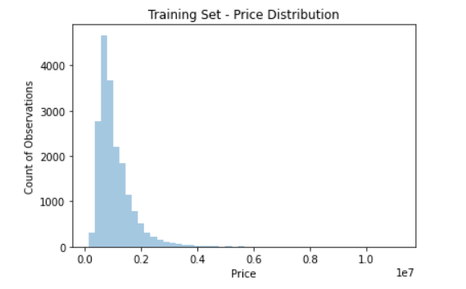
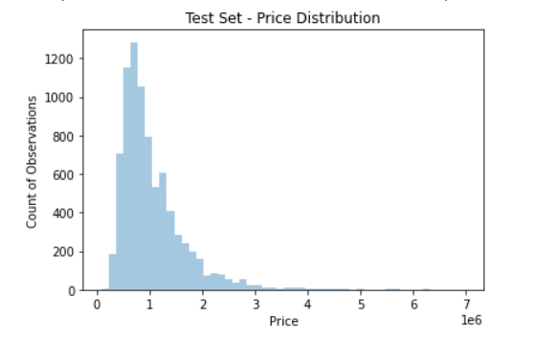
MODEL TRAINING
For model training, the data was split into training and test set
Model was trained on the training set (80% of the data)
Model was evaluated on the test set (20% of the data)
2 Models were tested on the data:
Model 1: Linear Regression
Model 2: ElasticNet Regression

Slide 18

MODEL 1: LINEAR REGRESSION
Identify w and b
While minimizing
ŷ = wX + b
Where
ŷ = predicted target variable
w = vector of coefficients
X = vector of input features
b = y-intercept
Model is fit using least-squares method
Minimizes the difference between predicted ŷ and actual y

Slide 19

MODEL 2: ELASTICNET REGRESSION
ŷ = wX + b
Identify w and b
While minimizing
Where
ŷ = target variable
w = vector of coefficients
X = vector of input features
b = y-intercept
Minimizes the difference between predicted ŷ and actual y while considering additional penalty of coefficients.
Regularization penalty 𝛂 applied to the weights is added to the cost function

Slide 20
MODEL RESULTS
Model | Training R2 | Testing R2
Linear Regression | 0.564 | 0.551
ElasticNet (alpha = 0.00001) | 0.564 | 0.551
Both models relatively the same performance; also likely due to alpha being small
Final model chosen was ElasticNet

Slide 21
INSIGHTS

Slide 22
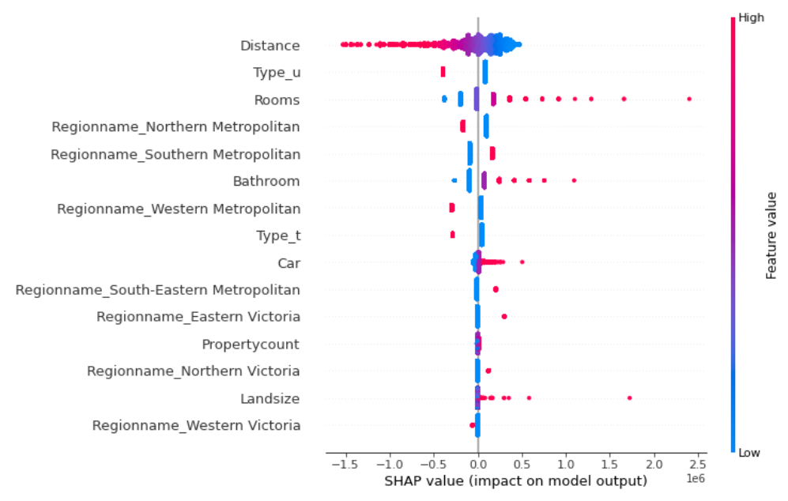
FEATURE IMPORTANCE (SHAP)

Slide 23
FEATURE IMPORTANCE (SHAP)
The farther the house is from the central business district, the cheaper the pricing is.
Notes:
The distance feature is negatively correlated with the target variable.

Slide 24
FEATURE IMPORTANCE (SHAP)
Units and townhouses tend to have Lower Prices.

Slide 25
FEATURE IMPORTANCE (SHAP)
Houses with more rooms have higher prices.

Slide 26
FEATURE IMPORTANCE (SHAP)
Houses with higher bathroom count, higher car parking spot count, and larger land size tend to have higher prices.

Slide 27
FEATURE IMPORTANCE (SHAP)
House Prices are cheaper in some regions.

Slide 28
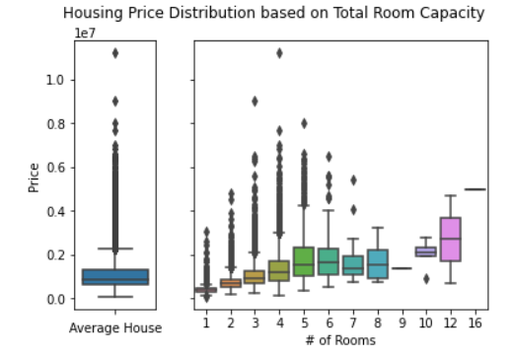
CONSIDERATIONS FOR MAXIMIZING HOME VALUE
Having more rooms needed will increase the housing price requirement
Larger families are disadvantaged with regards to price

Slide 29
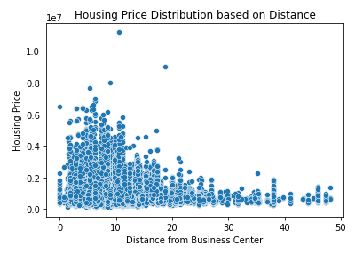
CONSIDERATIONS FOR MAXIMIZING HOME VALUE
People with larger families who still want lower house prices can consider:
Looking into areas farther from the business center

Slide 30
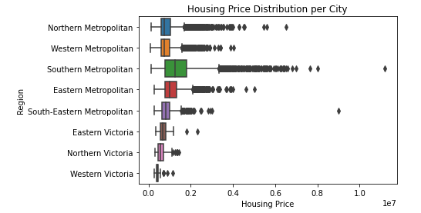
CONSIDERATIONS FOR MAXIMIZING HOME VALUE
People with larger families who still want lower house prices can consider:
Living in cheaper regions such as Northern Metropolitan, Western Metropolitan, and Western Victoria.

Slide 31
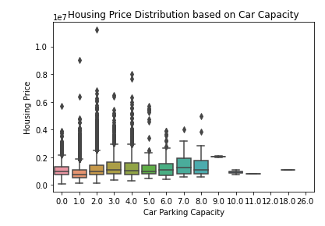
CONSIDERATIONS FOR MAXIMIZING HOME VALUE
People with larger families who still want lower house prices can consider:
Looking for houses that do not have as much car capacity, if any.

Slide 32
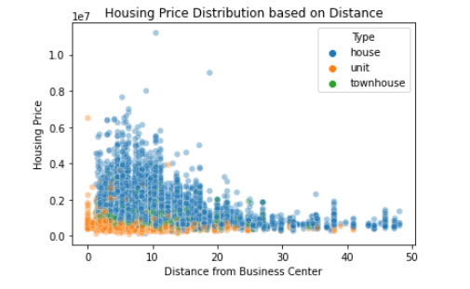
CONSIDERATIONS FOR MAXIMIZING HOME VALUE
People with larger families who still want lower house prices but need to be near the city center:
Can consider looking into townhouses or units instead; low price despite close distance to business center

Slide 33
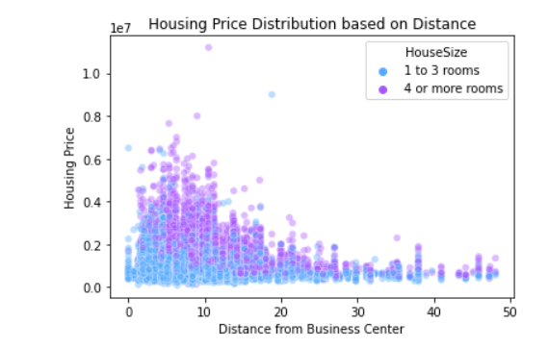
CONSIDERATIONS FOR MAXIMIZING HOME VALUE
Single people or smaller families who do not need as many rooms can consider smaller houses while still being near the center

Slide 34
CONCLUSION

Slide 35
CONCLUSION
We can predict the housing price using the limited features available before the purchase.
Some of the important features from the Trained Elastic Net model are Distance from business center, Type, and Count of Rooms.
Larger families are at a disadvantage in terms of pricing requirement due to room count
Trade-offs may need to be considered if lower housing price is needed
Smaller families have more freedom in other aspects due to low room count requirements

